Slide 1
Azure Migrate and Modernize Delivery Guide (Azure) RXT Delivery Team
For Internal Rackspace Migration Teams
(formerly known as AMMP)

Slide 2
Doc Control
Document Ref: | Azure AMM Delivery Guide
Version History
Author | Date | Version | Comments
Max Hurn | Apr-24 | v0.1 | Initial Draft for Solution Hub
Distribution
Name | Company | Role | Contact Details
Solution Hub | RXT | N/A | N/A
Please Log any changes to Doc.

Slide 3
Azure Migrate and Modernise Partner Lead - Assess
In time of writing Microsoft offer both field and partner lead opportunities.
Partner Lead Assess projects only receive a small amount of funding (5k) if they choose for the partner to do the assessment (Partner Lead). There are ‘t-shirt sizing’ engagements
Microsoft offer as part of Azure Assess & Plan Phase (Field Lead) 30k in partner funding to work with Microsoft and allow them to carry out the assessment with Dr.Migrate with some assistance from the partner (mainly carrying out the Cloud Adoption Framework, Landing Zone design) – this may be our opportunity to do a mini scoping and profiling session with the customer to get complexity scorings, to give us rough estimates on how long it’ll take to migrate each application.
This guide is aimed at if RXT perform the assessment and have no help from Microsoft (aka NOT Solution Assessment Route).

Slide 4
Azure AMM Assess
Why Do We Assess?
To discover the value and usage of the applications for the day-to-day business functions.
To understand the application components, current infrastructure and the wider ecosystem.
To determine an appropriate indicative migration approach per application.
Understand the business readiness to migrate into cloud and identify what resources will need to be bolstered.
To show the benefit of migrating into cloud, both technological and financial.

Slide 5
Welcome to Azure Migrate and Modernize
The goal of this delivery guide is to help better understand how the process of Azure Migrate and Modernize will run and what will need to be achieved by the end of the engagement.
The Azure Migrate and Modernize programme is from Azure which aims to accelerate migrations into their public cloud platform for various companies.
There are incentives for customers to go through the programme, such as paying Rackspace to carry the work out for them with little or no cost to the customer. It’s best to ensure to keep to up to date with the current benefits customer can utilise, as during the writing of this documentation there was a recent change to this (which could happen again). Engagements may be ‘rapid’ assessments which could be more infra focused with some insight into first mover apps that can be decided with the customer via workshops.
The following slides are an overview of the programme, the various assessments you may face and a general timeline of a assess project. The below link is further details on partner vs field led opportunities.
Azure Migrate and Modernize & Azure Innovate Partner-Led Collection of assets

Slide 6

Assessment Routes
Customer wants to move to cloud
and requires an assessment, customer’s cloud
of choice is Microsoft Azure.
There are various assessment routes that a customer can go down, this is a breakdown of each of those routes.
Rapid Assessment
Mainly focusing on infrastructure,
identify first movers / up to 5 apps complexity assessed, rough TCO, MRA.
Tools used:
- Azure Migrate only (depending on how rapid of an assessment is required)
Or
- Dr. Migrate (which requires Azure Migrate also deployed)
Advanced Assessment
All apps complexity assessed, up to 5 apps fully profiled, release plan, first movers, refined TCO, MRA.
Tool used:
- Dr. Migrate with validation exercises afterwards to ensure the customers' needs are met.
Cloud Readiness Assessment
Full Scoping and Profiling of applications, release plan, first movers, refined TCO, full CRA.
Tool used:
- Dr. Migrate with validation exercises afterwards to ensure the customers' needs are met. Deeper dive into applications that require refactoring or modernising.
Microsoft Solution Assessment
Microsoft have their own versions of assessments (main focus is similar to Rapid and Advanced Assessments)
We will nominate customers for this programme and Microsoft will carry out the assessment and work with us to tell the correct story to the customer on next steps and final deliverables.
Rackspace is pushing to utilise this initiative but may not live forever, so we have the other assessments in place as a failsafe.
M O B I L I Z E P H A S E

Slide 7
Migration method at-a-glance
Assess
Mobilise
. Creates a case for change .
. Mobilisation through experiences .
Rapid discovery
Financial Assessment
Detailed assessment
Migration planning
Design and build landing zone
Migration first mover
Security and compliance
Migration Governance
Cloud Readiness assessment
Portfolio assessment
Business Case
Infrastructure capture
Complexity Assessment
Release Plan
Client workshops and education
Application charter
Validated Business Case
Validated Release Plan
Build Landing zone
Migration Strategy & Design
First mover PoC
Security and Compliance review
Establish cloud centre of excellence
Migration & Operating cost management
Establish Operating model
Project planning
Migrate and Modernise
. Accelerate Migration @ Scale .
Cloud Native
Application Modernisation
Platform Modernisation
Move
Cloud Ops
Rewrite Application to be Cloud Native
Refactor Application to benefit from automation and cloud services
Application remains unchanged, but Supporting Services are modernised
Like-for-like migration to cloud, with little to no architecture changes
Migration Services

Slide 8
Assess Phase
The Assess phase is designed to accelerate your project from inception to confidence, working with experts to build understanding of current state, future state, and route to change.
DISCOVERY
OUTCOMES
Cloud Consultants & Architects will work with you to:
Understand & document your current state
Deploy & run discovery tools (where needed)
Provide High-Level Design (HLD) for Cloud Target
Provide indicative migration plan & strategy
Provide indicative business case, including TCO and Migration Costs.
Rapid/ Infrastructure
Discovery*
Discovery Workshops
Migration readiness
observations
Application scoping
& profiling summary*
Complexity
classification
*Optional tools Azure Migrate / Dr. Migrate
ASSESSMENT
Indicative migration strategy*
Target landing zone design
Preliminary
release plan*
Portfolio Assessment
Financial Assessment
Cloud Readiness Assessment
Estimated cost of
migration & operation
First mover
apps identified
Education
*Dependent on assessment type
6 WEEK TIMELINE
Migration Services

Slide 9
Azure AMM Assess Journey
Initiation
Assessment
Discovery
Engage
CRA (Lite)
Portfolio Assessment
Application
Profiling
Architecture
Review
Infrastructure
Discovery
Customer Kick Off
Scope Review
Business Overview
Drivers
Objectives
Workshop Planning
Tooling Partner Kick Off
Pre-questionnaire
CRA Workshops
Focus on Cloud Readiness
Defining assessment scope
(up to 5 Business apps)*
PA workshops validating data collection
Documentation Review
App Profiling Workshops
Complexity Assessment
Business Context
Key App data points captured
Architecture & Eco-System Workshops
Landing Zone Workshops
Tool Deployment
Infrastructure Data Capture
Dependant on assessment type*
Close
Showcase
Close
Playback
Analysis
Feedback
Lessons Learnt
Project Review
High Level Release Plan*
High Level Target Platform Design
Cost of Migration & Operation
CRA playback
PA Playback
Migration Scope Recommendations
Migration Strategy per Application
Complexity Scoring
Move Groups*
Dependant on assessment type*
Migration Services

Slide 10
SMART Assessments
‘From business planning to training to security and governance, find out what you need to do to prepare for your Microsoft Azure migration with the Strategic Migration Assessment and Readiness Tool (SMART).
The assessment walks you through a series of questions to help assess your readiness in regards to:
Your current business strategy
Your partner support system
Your inventory and assets
Your business goals
Your migration plan
Your organizations technical and migration skills
Your landing zone environment
The governance you have in place
How you will manage assets and services in the cloud
You have the ability to pick an area of focus, or answer all the assessment questions. When you finish, you'll receive a report that identifies areas for improvement and resources that can help you make those improvements. After you make improvements, you can come back and take the assessment again to gage your progress toward migration readiness’
Above is from Microsoft’s Website. The goal of the SMART assessment is to spot areas of weakness within the business when it comes to the migration, simple things such as knowing what teams would be part of the migration, has security and backups been considered in the cloud etc that the client may not have thought about. The recommendations can then help gear them up prior to the execution of migrations. The topics that are covered should be talking points and really pull out a good understanding of the customers current situation so a good analysis can be done on their readiness journey.

Slide 11
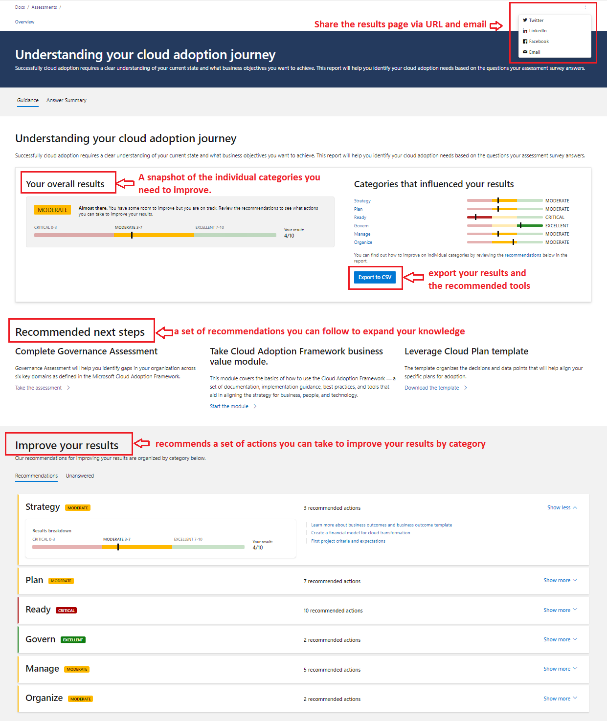
SMART Assessment Results

Slide 12
Tasks Timeline
Week 1
Week 2
Week 3
Week 4
Week 5
Week 6
High level Project Plan
Engage
Workshop Calendar
Scope Confirmation
PA
Application Portfolio Scoping and Profiling Workshops
Migration Strategy and Release Plan
Tool Discovery
Tool Based Discovery
MRA / Smart Assessment Workshops
MRA
MRA Playback Build & Showcase*
*Can be combined with Project Playback
LZ Design Workshops
LZ Design
LZ High Level Design
Business Case & Playback
Business Case Workshops (Optional)
Business Case Prep and Build
Project Playback Build & Showcase

Slide 13
Pre-Engage / Pre-Kick Off
Prior to kick off an internal kick off should be carried out, utilise this kick off call to:
Gain a better idea of the customer from the pre-sales team or customer success manager.
Ensure all roles and responsibilities are clearly outlined and each resource knows their part to play in the assessment.
Share information about the customer between resources, this could include an application list that has already been sent by the customer, any concerns from the customer, any issues the team feels they’ll face.
Decide (and if possible deploy) the tooling of choice (this will be usually Dr.Migrate)
Share Workshop Guidelines, respective teams may have different templates or workshop plans, be sure to check internally if you are unsure how workshops should be structured.
Plan the customer kick off deck and date. Ensure there’s enough time for all teams to be happy with the deck that will be presented to the customer.

Slide 14
Preparation
MRA Assessment
Portfolio Assessment
Discovery Tooling
Business Case
Familiarise yourself with the questions to be asked to customer – there are 6 pillars to understand: Platform, Security, Ways of working, Operations, Cost Management and Data Management.
Feel free to send the questions to the customer ahead of the workshop so they can start to prepare their answers, or even fill out the sheet and validate answers on the call. The goal is to create conversation and gauge where the customer is on their cloud journey.
The CRA template can be found here.
A SMART Assessment may also be carried out alongside MRA – more info on following slides.
TC / SA responsibility.
MPA is Rackspace’s version of scoping and profiling. There is a reduced scoping and profiling template to be used that can be found here for Rapid Assess or full scoping and profiling template can be found here for Adv & CRA Assessments.
To be able to start scoping and profiling properly an application list needs to be provided. Really push for this from day 1 of meeting the customer.
If Dr. Migrate is used as a discovery tool of choice (Licensing requirements) then a lot of assessment may be carried out by the tool and give a great base for the TC to work off of. [Example of Exports]
Prepare a demonstration deck or a way to showcase how the workshops will run or how the template can be filled out offline.
TC Responsibility.
If a discovery tool isn’t decided by customer or partner then you have 3 main options within Azure. Azure Migrate, Movere & Dr. Migrate.
Azure Migrate – Azures own discovery and migration tool, which can be deployed both agent or agentless. Both Movere and Dr.Migrate can integrate closely with it – More info
Movere – Only available via Solution assessments (by Microsoft), this is SaaS based product used only for assessments (Azure migrate recommended for migrations) – More info
Dr.Migrate – From LAB3, this utilises Azure Migrate and is an added ‘layer’ that uses AI to pull a lot more insights than Azure Migrate alone. At time of writing RXT has become a Dr. Migrate Partner and is pushing this tool heavily - More info
Engineer / SA responsibility – TC will help utilise the data.
Business case hinges heavily on the Portfolio Assessment and Discovery tooling outputs. Therefore it’s vital to ensure the tooling is deployed quickly, if possible even before the engagement properly kicks off. Delays in tooling deployment or MPA completion means the business case becomes harder to complete on time and will be rushed towards the end of the engagement.
Business creates a case for change within the company that can also be utilised to take to relevant stakeholders to convince the migration to go ahead, this is a vital deliverable that needs plenty of attention.
SA / Customer Success Manager Responsibility.

Slide 15
Workshops
MRA Assessment
Portfolio Assessment
Discovery Tooling
Business Case
Workshops should be 1-2 hours and have at least two workshops on this. If you chose to give the questions to the customer to fill in, still validate the answers and obtain any further information / allow the CA to also ask relevant questions. Capture any additional notes.
After tallying all the scores you’ll be able to produce a radar chart and show this back to customer or include in your playback to customer. Areas that need work will be highlighted and explained to the customer what will need to be considered when moving into the next phases.
Workshop Guide Found Here
TC/CA Responsibility – Heavy customer involvement.
Portfolio Assessment workshops are going through the template (on previous slide) on the call and getting a better understanding of the applications in the env, this also gives the SA an opportunity to ask any other questions during the data gathering phase.
Some customers will ask to do this offline, due to various reasons. Such as application owners being busy or the company is sub divided into multiple businesses, this is possible, however schedule regular check ins to see how the data gathering is going. It’s vital to highlight which areas are required for us to perform our assessment.
MPA Workshop Agenda
TC Responsibility – Heavy customer involvement.
Discovery tooling workshops will primarily be used to help customers install and troubleshoot any issues with the tooling.
Internal workshops or meetings should be held to review findings / what to feedback to customer if findings aren’t coming back as expected.
Dr. Migrate is a very powerful tool that will do a lot of heavy lifting / validating findings, there are license requirements therefore will require valid use case in order to get approval. Dr Migrate will require both Azure Migrate and then Dr. Migrate deployed on top, this will need to be considered when it comes to timelines. If Dr. Migrate is the tool of choice to get these deployed ASAP.
Engineer/Tooling partner responsibility – Some customer involvement
Business case workshops will be held in order to get a better understanding of what the customers' needs are and how we can help them on their cloud journey. There may be some cross over with the MRA assessment.
All teams will need to help provide info to build the business case, this exercise will also help build the SoW
SA/Customer success manager responsibility – Some customer involvement.

Slide 16
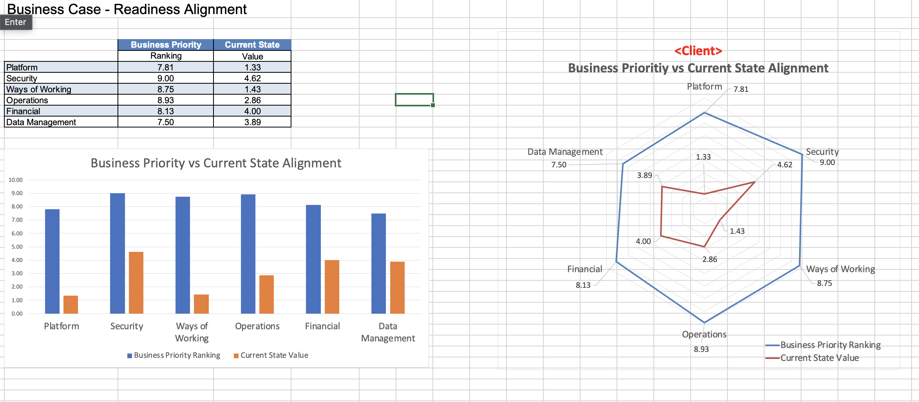
MRA Assessment
The MRA Assessment is designed to get a baseline level idea of the customers estate and how prepared they are to move into cloud. It’s to be used as a dialogue with the customer, rather than simple question and answer, meaning both CA and TC should be present on the calls, in order to cover all areas and get a better understanding for the customer.
We want to utilise this to gain the customers confidence in us, that we’ve not only thought of the migration of the actual applications, but the impacts surrounding the actual event.
The questions here will provide a strong framework, however they are not rigid. Every customer is unique and has variety in their estate, ask relevant or more probing questions where it seems fit. Notes can be made to refer back to and carry on throughout the project. Remember knowledge is power!
When the template is complete, you will get a radar and bar chart as shown below, showing the customers goal vs current state env.

Slide 17
SMART Assessments
SMART Assessments are a tool from Microsoft – This could be used for Rapid Assessments or alongside MRA’s. This provides a high level overview and reccomendations from Microsoft based on the answers given to their questions.
‘From business planning to training to security and governance, find out what you need to do to prepare for your Microsoft Azure migration with the Strategic Migration Assessment and Readiness Tool (SMART).
The assessment walks you through a series of questions to help assess your readiness in regards to:
Your current business strategy
Your partner support system
Your inventory and assets
Your business goals
Your migration plan
Your organizations technical and migration skills
Your landing zone environment
The governance you have in place
How you will manage assets and services in the cloud
You have the ability to pick an area of focus, or answer all the assessment questions. When you finish, you'll receive a report that identifies areas for improvement and resources that can help you make those improvements. After you make improvements, you can come back and take the assessment again to gage your progress toward migration readiness’
Above is from Microsoft’s Website. The goal of the SMART assessment is to spot areas of weakness within the business when it comes to the migration, simple things such as knowing what teams would be part of the migration, has security and backups been considered in the cloud etc that the client may not have thought about. The recommendations can then help gear them up prior to the execution of migrations. The topics that are covered should be talking points and really pull out a good understanding of the customers current situation so a good analysis can be done on their readiness journey.
LINK TO SMART ASSESSMENT TOOL

Slide 18
SMART Assessment Results
Alongside these results customers can add milestones to show the progress they are making with the recommended actions.

Slide 19
PA Portfolio Assessment
The Portfolio assessment is Rackspace’s scoping and profiling (however this may be a lighter version due to the rapid nature of some of these assessments), key details will need to be captured with the customer to be able to do a migration assessment on the applications. If the project is very rapid then first movers should be identified and assessed first, any extra time on other applications is a bonus, however other applications will most likely be covered in the next phase – MIGRATE.
As mentioned before the application list is so important to get a rough idea of the estate the customer is looking to migrate, this then can also highlight any shared services that the solutions architect needs to consider as part of the high level design.
Azure Migrate will help with TCO calculations, the PA will help narrow down the scope of work and potentially any modernisation opportunities if spotted by the CA or flagged by the customer.
For this phase only 5 business applications will be application profiled, this is to keep us on track for margins with the funding from Microsoft. You will need to work with the customer to define these 5 apps and the rest of the assessment will be on the infrastructure. In the following phase we will then complete the scoping and profiling of the rest of the business apps, alongside the first movers being migrated and utilise the funding in that phase.
However if Dr. Migrate is used this can give us a good high level wave plan and categorise apps and use as a base for cost estimations and timelines.
Linked is a Data Gathering Template Guide – for what goes into the sheet (based off our scoping and profiling product)
Deliverables from PA:
Complexity Assessment (on each application)
Migration Scope
High Level release plan (first movers)
First Movers Identified
Estimated Cost of Migration (TC cost)
Scoping and profiling / PA workbook
PA Playback
Migration Strategy per application (first movers)

Slide 20
Discovery Tooling
The Discovery tooling will be vital to getting a good idea of the current estate the customer is working with, it’s utilised alongside MPA and MRA Assessment to really see the customers desires and any weak points or areas that need to be addressed early on, in preparation for the next phase.
Using the tooling and workshop approach, we are able to really pin down how much of the estate is going to be migrated and give a more accurate TCO.
Stress to the customer the importance of getting the tooling set up ASAP. If possible this should be pre-arranged or be in talks to prepare the customer to put in any requests that may be needed in order for this to be set up. Majority of projects delays are because tooling isn’t installed properly, or because of the customer, it’s best to mitigate any delays on our side by ensuring tooling is in place ASAP.
Tooling also highlights early on any VM’s the customer may of forgotten and needs to decommission or needs to be excluded, on the flip side it’s the same for any VM’s that may have been forgotten and needs to be included.
An engineer always needs to be lined up for these type of engagements, another delay is not having the resource to support the customer, if you notice an engineer is missing then flag it as early as possible!
Azure Migrate Deployment Guide [Scenario dependant on website]
Dr. Migrate Deployment Guide [Azure Migrate needs to be installed first]
Movere Deployment Guide [SaaS]
Azure Migrate and Dr. Migrate Deployment Guide
The following deliverables will come out the Discovery tooling:
Discovery tooling itinerary/report – (used to help app to server mapping and TCO)

Slide 21
Discovery Tooling – Dr. Migrate
The Discovery tooling that Microsoft will prefer to use is Dr Migrate (Rackspace is now a Dr Migrate Partner as well) – This is due to the capabilities it has in extracting data and provide a great start for wave planning, migration strategies and even identify apps we may be utilising this output more than going via assessments with the customer.
‘SuperCharged Low Down’ On Dr.Migrate Video (8 mins)
“Responding to the pain points, LAB3 has “supercharged Microsoft’s Azure Migrate appliance” by providing an agentless service. This means that customers don’t need to install agents on every virtual machine. The Microsoft approved tool automatically learns how the company’s applications relate, calculates the best applications to migrate and then cleanses the system of old applications using infrastructure-as-code. It then integrates the migrated virtual machine with native Azure services. “The technology shows an end-to-end report of what has migrated into Azure,” says Andy. Dr M’s algorithms know which app needs to move with another, as it automatically detects their network dependences. Traditionally, these plans would take weeks to build. Now they generate in an instant.”

Slide 22
Business Case
Why do we need a business case? – The Business case provides a baseline, and a projection of future value. It provides a comparison of continuing to operate as is (do nothing) against the value of transitioning into Azure (future change) – The final product of the business case will lead to a draft SoW being created ready for the mobilise phase.
Business Case Template (Example) – This Document isn’t an ‘official’ creation, at time of writing there isn’t an Azure AMM specific Business Case Template. This is a generic business case that’s been tailored to Azure AMM. Screenshots or data from this exercise can be injected into the business case to support areas where needed.
Business Case inputs: (These details will have to come from various members of the team / customer)
Azure key components for creating a business case
(Tools for TCO included in this link)

Slide 23
Business Case
The business case covers the following topics: Executive Summary –
Background on the engagement / client
The Purpose of the Business case
The intended audience
References for the Business case
Migration Context –
An overview of organization and it’s technology landscape
Including Company Name, Relevant Business Units, Stakeholders and Data Centre Locations.
Migration Assessment –
A summary of the infrastructure and applications in scope based on the discovery
Assets will be included (tables / graphs with info) around which applications are in scope, servers, and databases
Migration Strategy –
A summary MAP programme and how the various phases work
Overview of the 7 R’s
Migration recommendations per application assessed.

Slide 24
Business Case
The business case covers the following topics: Total Cost of Ownership –
A Comparison between staying as-is or migrating to cloud
Estimated Savings
Cost Breakdown
Cost Flow Breakdown and Detailed Breakdown
Migration Cost (into Azure)
Benefits of Migration to Azure
1-5 year cost breakdown and benefits year on year.
*Optional – Sustainability calculations (Carbon Footprint) - Only available via Migration Evaluator
Migration Planning –
Overview of Application Profiling
High-Level Release Plan for assessed applications
Conclusion –
Summary of Business Case and next steps

Slide 25
Types of business cases
Includes migration costs, application assessment, and migration plan.
Detailed
Business Case
Directional Business Case
Business Value Analysis
Includes migration costs.
Directional Business case is what is required for Azure AMM Assess
End-to-end value comparison between a traditional IT environment and an Azure environment

Slide 26
Playback Prep
Be Prepared for the playback – The playback will require the whole team to work together to have a coherent flow but also cover all the data points to the customer. A good rule of thumb to follow is –
What have we done?
What did we find?
What are our recommendations?
What are our solutions?
How long will this take?
How much will it cost?
The flow can be shifted around depending on the customer and what you feel is best suited to them, but as a guideline this can be helpful for steering the conversation. A reminder of all the work we’ve done to get to this point sets a good energy for the meeting, before getting into the more nitty gritty details further along the presentation.
Key Metrics to include are – applications in scope, how many of each complexity, timelines for each wave/part of the migration, how many servers are in scope, how many shared services the customer has and need to be considered, total cost of ownership, how many servers are out of scope, how many apps are in each migration strategy (and why).

Slide 27
Playback Prep - With Dr. Migrate
Playback with Dr. Migrate findings will also shape how we present back to the customer. A variety of reports are generated and help shape the decisions that can be made by customer when moving into the next phase.
The Data from Dr. Migrate needs to be verified and spoken through with the customer. Ensure all apps are tagged correctly with the R treatment plan, and if doing a Rapid Migration to focus on 5 first movers, and if there is time start validating the auto discovered apps as well.
Review the exports and reports from Dr. Migrate and familiarise yourself with what slides may be best suited for your customer case. Cherry pick the best slides / useful info to put into your playback deck.
Dr. Migrate have their own playback system that may be helpful in some engagements, the playback is ultimately how you best see fit to showcase the solution / findings to the customer. It’s worth reviewing the playback deck example on the next slide and see what baseline info should be included.

Slide 28
Dr. Migrate Example Reports
Dr. Migrate has two types of reports ‘Rapid Migration insights’ and ‘Holistic insights’.
Rapid migration insights (also known as foundation report / insights) allows a same day insight into the customers estate and a very quick view of what their migration journey might look like from a high level.
Holistic insights are a lot more in-depth, and have a summary of the work that’s been done in the portal with the customer. This includes the R-Treatment plan, app complexity sizing, wave planning, TCO etc. The Holistic insights report is a version of a final playback deck, it would be wise to include some slides into the final playback, or follow a similar format for showcasing the data. Try to add ‘Rackspace Value’ vs simply ‘using the Dr. M deck’.
Example of ‘Rapid Migration Insights’
Example of ’Holistic Insights’
Further Dr. M Example documents

Slide 29
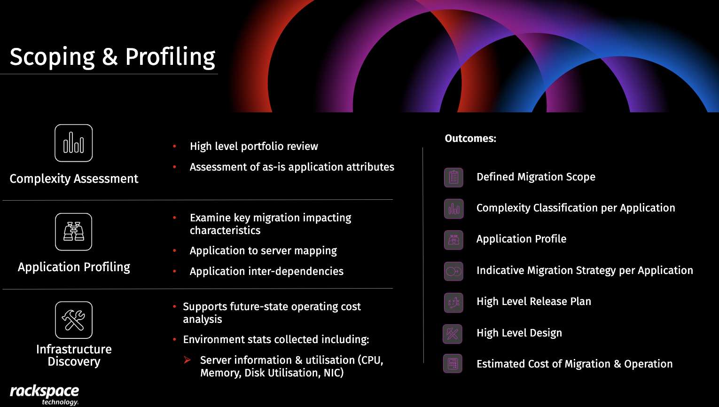
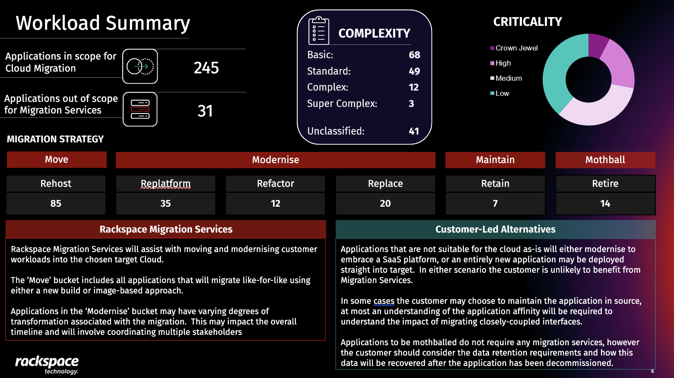
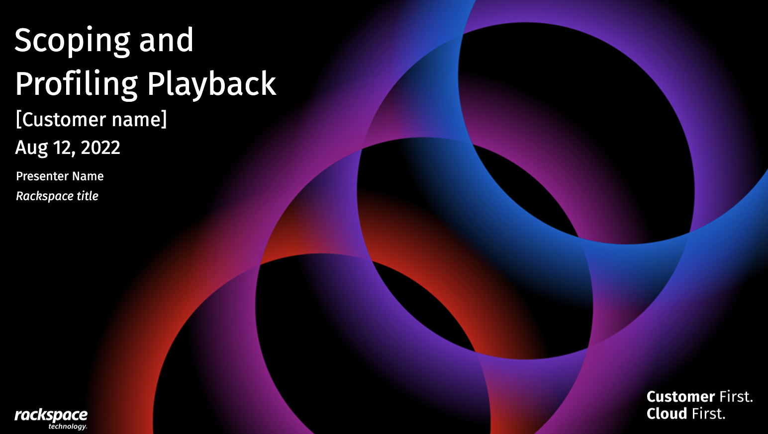
Playback
At the end of the engagement the playback of Rackspace’s findings will be vital to helping the customer see the value in the work we do. There is a template of the a scoping and profiling playback that can be tailored for Azure AMM. On occasion playbacks will be separated, into MRA, MPA, and Business case, or consolidated depending on if there’s delays or other factors. Do what feels best for you and the team to deliver the best for the customer.
Example Playback here. The order of the deck can be changed depending on customer or project requirements. [Azure Version to be added]

Slide 30
RACI for AMM Assess
 | Responsible | Accountable | Consultable | Informed | INPUTS | OUTPUTS
Project Plan | PM | PM | All | All | All | A guide of timelines to keep team on track
MRA | TC/CA* | TC/CA* | Customer | PM | Customer | MRA Report and playback
PA | TC | TC | TC/CA | TC/CA | Customer | MPA Analysis
Tooling Deployment | CE | CE | CA/CE | All | CA/CE | Infrastructure captured
Business Case | All | CP | CA/TC/CE | All | All | Document proving a case for change
Playback | All | All | All | All | All | A powerful document and presentation showcasing our work and why the customer should move forward with the mobilise phase
*Can be performed by either role
PM – Project Manager
TC – Technical Consultant
CA – Cloud Architect
CE – Cloud Engineer
CP – Client Partner

Slide 31
RACI for MAP Assess – MRA Assessment
 | Responsible | Accountable | Consulted | Informed | INPUTS | OUTPUTS
Agenda | TC/CA* | PM |  | PM | TC/CA | MRA – Workshop Agenda
MRA Tool Set up | TC/CA* | TC/CA* |  |  | Customer | MRA - Prep
Workshops | TC/CA* | PM |  | PM | Customer | MRA - Report
MRA Report Playback | TC/CA* | TC/CA* |  | PM | TC/CA | MRA – Playback Deck
LZ Workshops | CA | CA | TC | PM/CP | Customer | Landing Zone Design
*Can be performed by either role
PM – Project Manager
TC – Technical Consultant
CA – Cloud Architect
CE – Cloud Engineer
CP – Client Partner *Are client partners on these engagements?

Slide 32
RACI for MAP Assess – Tool Deployment
 | Responsible | Accountable | Consulted | Informed | INPUT FROM | OUTPUTS
Tool Deployment Guide | CE | CE | CA | TC / PM |  | Tool Deployment
Trouble shooting sessions | CE | CE | CA | PM | CE | Tool Deployment
Tool Management | CE | CE |  | PM | CE | Tool Report / Status Updates
Tool Output | CE | CE |  | TC/CE/CA | Tooling | Export / Infra report
App to Server Mapping (tool) | TC/CE | TC |  | All | Tool Output | Validated MPA Report
PM – Project Manager
TC – Technical Consultant
CA – Cloud Architect
CE – Cloud Engineer
CP – Client Partner *Are client partners on these engagements?

Slide 33
RACI for AMM Assess - PA
 | Responsible | Accountable | Consulted | Informed | INPUT FROM | OUTPUTS
Agenda | TC | PM |  | PM | TC | Workshop Agenda
Workshops | TC | PM | CA | PM | Customer | MPA Doc
MPA Document | TC | TC | CA/CE | PM/CP/CA | Customer | MPA Analysis
Complexity Assessment | TC | TC |  | All | MPA Doc | MRA – Playback Deck
High Level Release Plan | TC | TC |  | All | Complexity assessment | High Level Release Plan
Migration Scope | TC | TC |  | All | Customer | Migration Scope
First Movers | TC | TC | Customer | All | MPA Doc | First Movers identified
App to Server Mapping (Customer) | TC | TC | Customer | All | Customer | Initial app to server mapping
Migration Strategy | TC | TC | CA | All | MPA Doc /Customer | Migration Strategy per app
PM – Project Manager
TC – Technical Consultant
CA – Cloud Architect
CE – Cloud Engineer
CP – Client Partner *Are client partners on these engagements?

Slide 34
RACI for AMM Assess – Business Case / TCO / Playback
 | Responsible | Accountable | Consulted | Informed | INPUT FROM | OUTPUTS
Agenda | CP? | CP |  | PM | CP | Workshop Agenda
Business Case Workshops | CP | CP |  | PM | Customer | Business case base
Business Case Build | All | CP | All | All | MPA / TCO | Business Case Doc
TCO | TC/CA/CE | CP | TC/CA/CE | CP | Team Deliverables | TCO for business case / playback
Playback | All | PM | All | All | Team Deliverables | Playback for Customer
PM – Project Manager
TC – Technical Consultant
CA – Cloud Architect
CE – Cloud Engineer
CP – Client Partner? *Are client partners on these engagements?

Slide 35
RACI for AMM - Solutions Assessment - TBC
 | Responsible | Accountable | Consultable | Informed | INPUTS | OUTPUTS
Nominating Customers | Rackspace | Rackspace | Microsoft | Microsoft | Rackspace | Customer put forward for AMM
Solutions Assessment | Microsoft | Microsoft | Rackspace | Rackspace | Customer | Data for Rackspace to Analyse
Portfolio Assessment (for timelines) | Rackspace | Rackspace | Rackspace | Microsoft / Customer | Dr Migrate Output | First Movers planed and Cost of Migration
Discovery Tooling Deployment | Microsoft | Microsoft | Rackspace | Customer / Rackspace | Customer | Infra captured / Network Mapping (when using Dr. M)

Slide 36
SOW Example
Below is a linked SOW that has all the key sections highlighted, such a project initiation, MRA, PA and business case. Ensure everyone is aligned with which part of the SOW they are responsible for and that all members are aligned that nothing is missing from the SOW.
As you can see the project is usually forecasted for 6-10 weeks (dependant on the assessment type), most delays are due to tooling or exports taking time. As repeated throughout this guide, it is important to get this tooling up and running as soon as possible as it’s the main cause of delays, combined with customer diaries not being accommodating.
See SOW Template example here

Slide 37
Azure Solutions Assessment Journey
Nomination
Solution Assessment & Discovery
Engage
Discovery
Output Review
Application
Maintainence
Architecture
Review
Customer is Nominated by Rackspace for Solution Assessment
Once approved Solution assessment begins and Rackspace support Microsoft with engagement
Dr. Migrate Deployed (by Rackspace if Rapid assessment)
Solution Assessment carried out by Microsoft (includes tooling deployment)
Data Given to Rackspace to analyse and give timelines to deliver project and initiate first movers. (Working with Customer and Microsoft)
Small workshops may be held to acquire:
Further clarification on customer estate
Identify first movers and modernisation candidates.
RXT have landing zone design templates for Azure ready to go.
Landing Zone Workshops for lower level details.
Close
Showcase
Close
Playback
Analysis
Feedback
Lessons Learnt
Project Review
Next Steps for Migrate Phase
Dr. Migrate Dashboard walk through
Showcasing the analysis by Dr. Migrate.
High Level Release Plan
High Level Target Platform Design
Cost of Migration & Operation
Dr. Migrate will output the following -
Migration Scope Recommendations
Migration Strategy per Application
Complexity Scoring
Move Groups
TCO
*Note some analysis may be required on solidifying the plan for customer.
Migration Services
Notes:
Carbon copy of AWS one with the same data

Slide 38
Important Links (Azure)
https://partner.microsoft.com/en-us/asset/collection/azure-migrate-and-modernize-partner-led-and-azure-innovate-resources#/ - Resources for AMM / Azure innovate
https://partner.microsoft.com/en-us/asset/collection/caf-ready-and-govern-workshop-material#/ - CAF Ready and govern workshop Material
https://learn.microsoft.com/en-us/azure/migrate/how-to-assess - Assessment tools within Azure Migrate
https://learn.microsoft.com/en-us/assessments/50adbf76-60fb-47ce-a787-f9d5f52f6a48/ - Microsoft App and Data Modernization Readiness tool –

Slide 39
Introducing Azure Offerings: Partner-led
Nominate customer projects to Azure Migrate and Modernize & Azure Innovate to accelerate their cloud journey, and track status via a self-service workflow
Self-serve workflow through Microsoft Commerce Incentives
Faster approvals via automation and standardized engagement sizes
Engagements are nominated and led by partners* across the customer journey
Scale faster
with more engagements from migration to Innovation
Note: *FastTrack for Azure assistance is available but not required
Notes:
With AMMP Partner-led, the ease, scale and speed are increased, and friction points are reduced – this path yields faster approvals and set engagement sizes (aka t-shirt sizing for S, M, L engagement sizes) which makes 'calculating' ACR much faster.
Now there is a new faster path available to Azure Specialized partners, AMMP Partner-led which is designed to provide an easy, friction free way to nominate customers for the Azure Migration and Modernization Program to drive scale and agility. Partners can now directly nominate customer projects to AMMP to migrate and modernize to the cloud and can secure engagement funding faster and at scale.
Funding is available in standardized engagement sizes in the Migration and Modernization offer with partners driving the entire process end to end. There will also be a self-serve tracking dashboard for these engagements. This new path should help to speed up approvals and funding distribution.

Slide 40
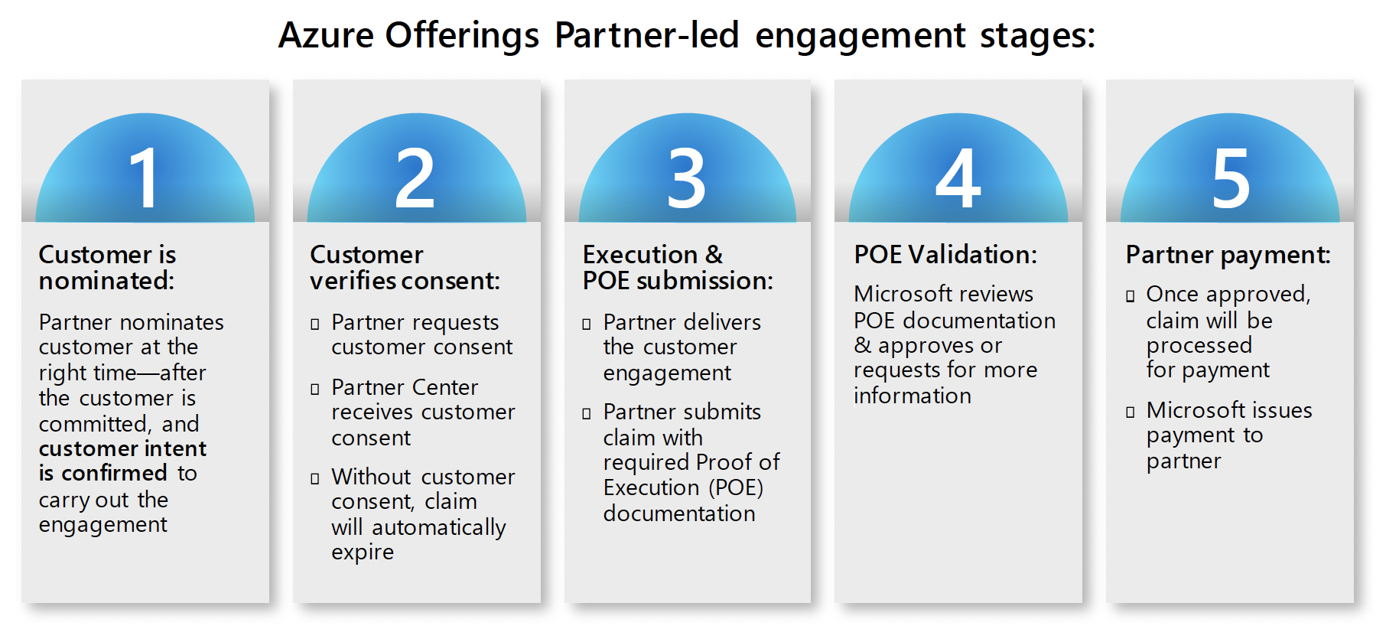
Breakdown of journey (repeatable for assess and migrate)
Customer is nominated by partner, Microsoft make sure to really check with the customer that they’re happy with what’s moving forward, if we do not meet minimum success criteria then partners may be suspended from nominating future engagements. (Pre-Sales job?)
Customer verifies consent
Execution and POE submission (Carry out the engagement)
POE Validation (show findings)
Partner Payment (Rackspace is paid)

Slide 41
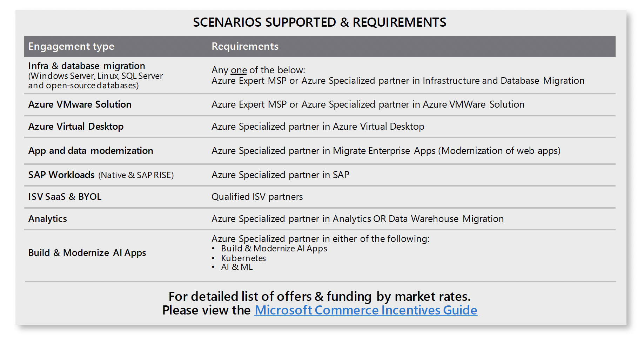
What phases of customer deployment are supported in Azure Offerings Partner-led?
Azure Migrate & Modernize supports:
1) Pre-sales: Assessments - Mini scoping and profiling?
2) Post-sales: Migration & Modernization Deployments – Migrating into Azure

Slide 42
Azure Migrate and Modernize Partner-led offers
UPDATED
Azure Specialized partners now have a path to directly nominate customers for Azure Migrate and Modernize in a self-service workflow. This agile path reduces time to market and can help partners drive scale.
Incentive payouts
SUPPORTED SCENARIOS
Offer | Eligibility (Planned Azure consumption in year 1) | Partner payment* | Phase
Migrate & Modernize assessments (Infra/DB, Migrate Enterprise Apps, SAP only) | Suggested project size: >$25K/year | $4,000 / $5,000 | Pre-sales
Migrate & Modernize XS – NEW! (Infra/DB migration only) | Project size: $10K–$25K/year | $4,000 / $5,000 | Post-sales
Migrate & Modernize Small | Project size: >$25K–$125K/year | $12,000 / $15,000 | Post-sales
Migrate & Modernize Medium | Project size: >$125K–$250K/year | $28,000 / $35,000 | Post-sales
Migrate & Modernize Large | Project size: >$250K–$500K/year | $40,000 / $50,000 | Post-sales
Migrate & Modernize XL (Infra/DB migration only) | Project size: >$500K–$750K/year | $60,000 / $75,000 | Post-sales
Migrate & Modernize XXL (Infra/DB migration only) | Project size: >$750K–$1M/year | $80,000 / $100,000 | Post-sales
Customer Skilling & FastTrack for Azure is optional for all offers ** No Azure credits available for these engagements
Infra/Database migration
Migrating to Azure VMware solution
Migrate Enterprise apps (updated)
Virtual desktop infrastructure
SAP migration to Azure
SAP RISE
ISV SaaS & BYOL (new)
1
2
3
4
5
6
7
Important: There are no limitations in Azure Migrate and Modernize Partner-led for different licensing types (EA, CSP, etc.)
Customer Criteria: All Majors, SMC-(Corporate & Scale) and SMB (with a TPID) customers are supported in Azure Migrate and Modernize Partner-led. (Strategic Customers are not eligible)
Important: To request Customer Skilling OR FastTrack for Azure support. Please email AzurePartnerOffering@microsoft.com with the Claim ID of the engagement after customer consent has been secured.
* See Microsoft Partner Commercial Incentives Guide for offer full details and requirements. Above project sizes are the planned Azure consumption in year 1, measured from project completion. Partner payment amounts may differ by country/Market A, B
** Customer self-directed skilling available in the Resources section of this presentation. Available for all offer sizes.
Offer size Medium or larger qualifies for Enterprise Skills Initiative which includes an assigned Training Program Manager.

Slide 43
Rapid Assessment Journey
Pre-workshop
Preparation
Pre-workshop data gathering
Via tooling or customer catalogue
Decide initial assessment scope
Identify key stakeholders / resources
Assessment
Focus
Defined Migration Scope
Application Complexity assessment
Application to Server Mapping
Indicative Migration Strategy per application
High Level Release Plan
High Level Design
Estimated Cost of Migration and Operation
Results
Key Data Points for Assessment
Bespoke or COTS
Number of application components
Number of Interfaces
Number of application Tiers
Number of Databases
Business Criticality
Compliance Level
Knowledge Level
Server Count
Operating System
Migration Services

